Slide 1
Cryptography and Network Security
Chapter 2
Fourth Edition
by William Stallings
Lecture slides by Lawrie Brown
Notes:
Lecture slides by Lawrie Brown for “Cryptography and Network Security”, 4/e, by William Stallings, Chapter 2 – “Classical Encryption Techniques”.

Slide 2
Symmetric Encryption
or conventional / private-key / single-key
sender and recipient share a common key
all classical encryption algorithms are private-key
was only type prior to invention of public-key in 1970’s
and by far most widely used
Notes:
Symmetric encryption, also referred to as conventional encryption or single-key encryption, was the only type of encryption in use prior to the development of public-key encryption in the 1970s. It remains by far the most widely used of the two types of encryption. All traditional schemes are symmetric / single key / private-key encryption algorithms, with a single key, used for both encryption and decryption. Since both sender and receiver are equivalent, either can encrypt or decrypt messages using that common key.

Slide 3
Some Basic Terminology
plaintext - original message
ciphertext - coded message
cipher - algorithm for transforming plaintext to ciphertext
key - info used in cipher known only to sender/receiver
encipher (encrypt) - converting plaintext to ciphertext
decipher (decrypt) - recovering ciphertext from plaintext
Notes:
Briefly review some terminology used throughout the course.

Slide 4

Symmetric Cipher Model
Notes:
Detail the five ingredients of the symmetric cipher model, shown in Stallings Figure 2.1:
plaintext - original message
encryption algorithm – performs substitutions/transformations on plaintext
secret key – control exact substitutions/transformations used in encryption algorithm
ciphertext - scrambled message
decryption algorithm – inverse of encryption algorithm

Slide 5
Requirements
two requirements for secure use of symmetric encryption:
  a strong encryption algorithm
  a secret key known only to sender / receiver
mathematically have:
  Y = E_{K}(X)
  X = D_{K}(Y)
assume encryption algorithm is known
implies a secure channel to distribute key
Notes:
We assume that it is impractical to decrypt a message on the basis of the cipher- text plus knowledge of the encryption/decryption algorithm, and do not need to keep the algorithm secret; rather we only need to keep the key secret. This feature of symmetric encryption is what makes it feasible for widespread use. It allows easy distribution of s/w and h/w implementations.
Can take a closer look at the essential elements of a symmetric encryption scheme: mathematically it can be considered a pair of functions with: plaintext X, ciphertext Y, key K, encryption algorithm E_{K}, decryption algorithm D_{K}.

Slide 6
Cryptography
characterize cryptographic system by:
  type of encryption operations used
    substitution / transposition / product
  number of keys used
    single-key or private / two-key or public
  way in which plaintext is processed
    A block cipher processes the input one block of elements at a time, producing an output block for each input block.
    A stream cipher processes the input elements continuously, producing output one element at a time, as it goes along
Notes:
Cryptographic systems can be characterized along these three independent dimensions.

Slide 7
Cryptanalysis
objective to recover key not just message
general approaches:
  cryptanalytic attack : algorithm + knowledge of text
  brute-force attack : possible key
Notes:
Typically objective is to recover the key in use rather then simply to recover the plaintext of a single ciphertext.
There are two general approaches:
Cryptanalytic attacks rely on the nature of the algorithm plus perhaps some knowledge of the general characteristics of the plaintext or even some sample plaintext-ciphertext pairs.
Brute-force attacks try every possible key on a piece of ciphertext until an intelligible translation into plaintext is obtained. On average,half of all possible keys must be tried to achieve success.

Slide 8
Cryptanalytic Attacks
ciphertext only
  only know algorithm & ciphertext, is statistical, know or can identify plaintext
known plaintext
  know/suspect plaintext & ciphertext
chosen plaintext
  select plaintext and obtain ciphertext
chosen ciphertext
  select ciphertext and obtain plaintext
chosen text
  select plaintext or ciphertext to en/decrypt
Notes:
Stallings Table 2.1 summarizes the various types of cryptanalytic attacks, based on the amount of information known to the cryptanalyst, from least to most. The most difficult problem is presented when all that is available is the ciphertext only. In some cases, not even the encryption algorithm is known, but in general we can assume that the opponent does know the algorithm used for encryption. Then with increasing information have the other attacks. Generally, an encryption algorithm is designed to withstand a known-plaintext attack.

Slide 9
Playfair Cipher
a manual symmetric encryption technique
technique encrypts pairs of letters, instead of single letters as in the simple substitution cipher
significantly harder to break since the frequency analysis used for simple substitution ciphers does not work with it.
The frequency analysis is possible, but considerably more difficult.
Notes:
Consider ways to reduce the "spikyness" of natural language text, since if just map one letter always to another, the frequency distribution is just shuffled. One approach is to encrypt more than one letter at once. The Playfair cipher is an example of doing this.

Slide 10
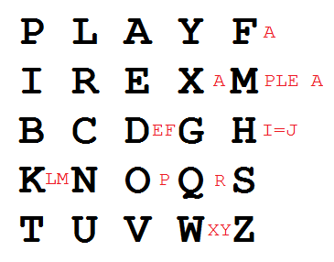

Playfair Key Matrix
a 5X5 matrix of letters based on a keyword
fill in letters of keyword (sans duplicates)
fill rest of matrix with other letters where assuming that I and J are interchangeable
eg. using the key “playfair example”
Notes:
The best-known multiple-letter encryption cipher is the Playfair, which treats digrams in the plaintext as single units and translates these units into ciphertext digrams. The Playfair algorithm is based on the use of a 5x5 matrix of letters constructed using a keyword. The rules for filling in this 5x5 matrix are: L to R, top to bottom, first with keyword after duplicate letters have been removed, and then with the remain letters, with I/J used as a single letter. This example comes from Dorothy Sayer's book "Have His Carcase", in which Lord Peter Wimsey solves it, and describes the use of a probably word attack.

Slide 11
Encrypting and Decrypting
Encrypting the message "Hide the gold in the tree stump“
plaintext is encrypted two letters at a time
  if a pair is a repeated letter, insert filler like 'X’
    eg. "balloon" encrypts as "ba lx lo on"
HI DE TH EG OL DI NT HE TR EX ES TU MP
Notes:
Plaintext is encrypted two letters at a time,according to the rules as shown. Note how you wrap from right side back to left, or from bottom back to top.
if a pair is a repeated letter, insert a filler like 'X', eg. "balloon" encrypts as "ba lx lo on"
if both letters fall in the same row, replace each with letter to right (wrapping back to start from end), eg. “ar" encrypts as "RM"
if both letters fall in the same column, replace each with the letter below it (again wrapping to top from bottom), eg. “mu" encrypts to "CM"
otherwise each letter is replaced by the one in its row in the column of the other letter of the pair, eg. “hs" encrypts to "BP", and “ea" to "IM" or "JM" (as desired)
Decrypting of course works exactly in reverse. Can see this by working the example pairs shown, backwards.

Slide 12
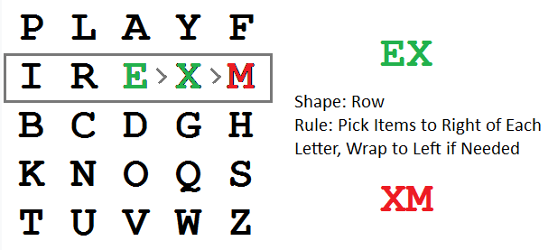
Encrypting and Decrypting
if both letters fall in the same row, replace each with letter to right (wrapping back to start from end)
RM -> EI
EX -> XM
XE -> MX

Slide 13
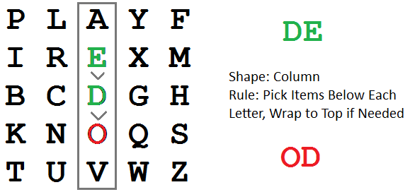
Encrypting and Decrypting
  if both letters fall in the same column, replace each with the letter below it (again wrapping to top from bottom)
EV -> DA
Jo yx -> EK XG -> IO YX / Joyx

Slide 14
BSSE SECOND BATCH
b | s | e | c | o
n | d | a | t | h
f | g | I | k | l
m | p | q | r | u
v | w | x | y | z
Plaintext: Software Engineering
SO FT WA RE EN GI NE ER IN GX
Chipertext: EB KN

Slide 15
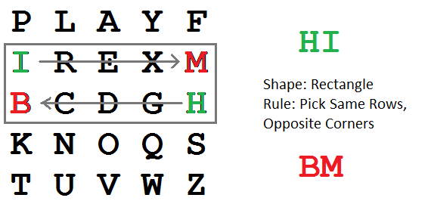
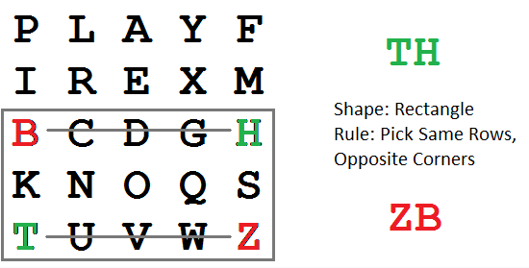
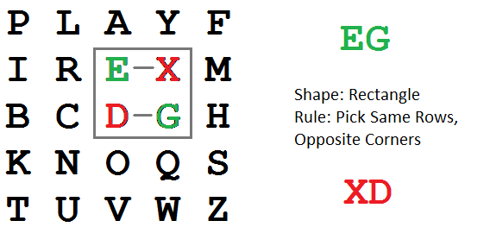
Encrypting and Decrypting
  otherwise each letter is replaced by the letter in the same row and in the column of the other letter of the pair

Slide 16
Security of Playfair Cipher
since have 26 x 26 = 676 digrams
would need a 676 entry frequency table to analyse
and correspondingly more ciphertext
was widely used for many years
  eg. by US & British military in WW1
it can be broken, given a few hundred letters
since still has much of plaintext structure
Notes:
The Playfair cipher is a great advance over simple monoalphabetic ciphers, since there are 26*26=676 digrams (vs 26 letters), so that identification of individual digrams is more difficult. Also,the relative frequencies of individual letters exhibit a much greater range than that of digrams, making frequency analysis much more difficult. The Playfair cipher was for a long time considered unbreakable. It was used as the standard field system by the British Army in World War I and still enjoyed considerable use by the U.S.Army and other Allied forces during World War II. Despite this level of confidence in its security,the Playfair cipher is relatively easy to break because it still leaves much of the structure of the plaintext language intact

Slide 17

Hill cipher
Hill cipher is a substitution cipher based on linear algebra.
Encryption & decryption
  Each letter is represented by a number modulo 26.
  Though this is not an essential feature of the cipher, this simple scheme is often used
  To encrypt a message, each block of n letters is multiplied by an invertible n × n matrix, against modulus 26.
  To decrypt the message, each block is multiplied by the inverse of the matrix used for encryption.
  The matrix used for encryption is the cipher key, and it should be chosen randomly from the set of invertible n × n matrices (modulo 26).

Slide 18


Hill cipher: Encrypting and Decrypting
Key
Plaintext

Slide 19
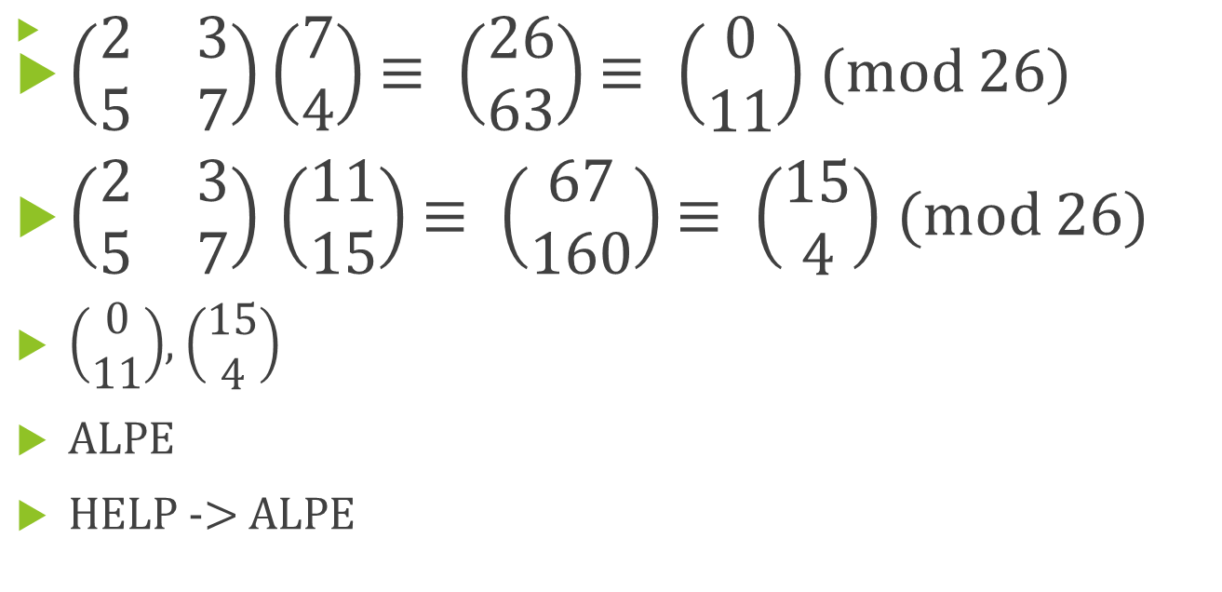
Hill cipher: Encrypting and Decrypting

Slide 20
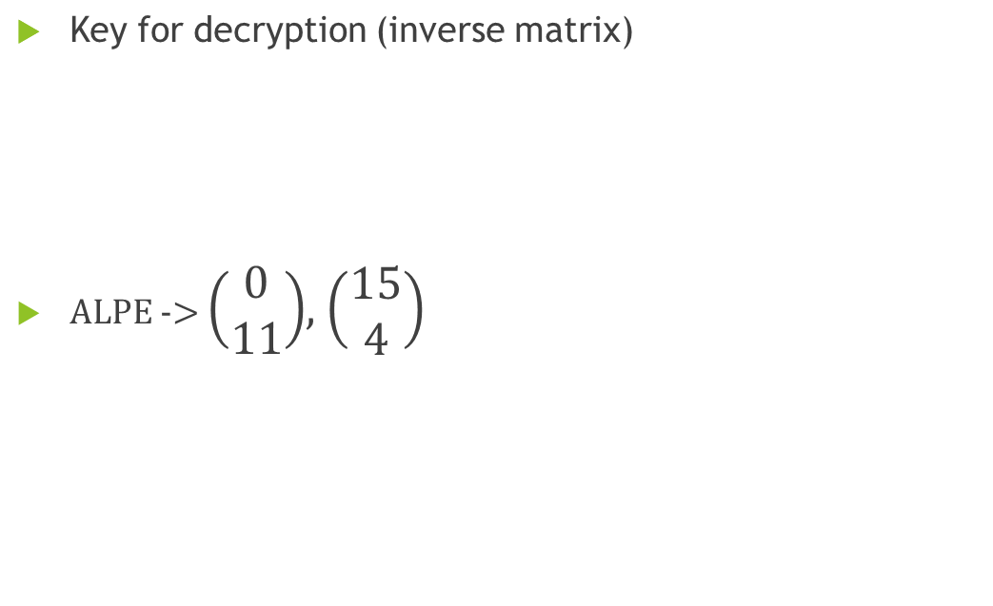

Hill cipher: Encrypting and Decrypting

Slide 21
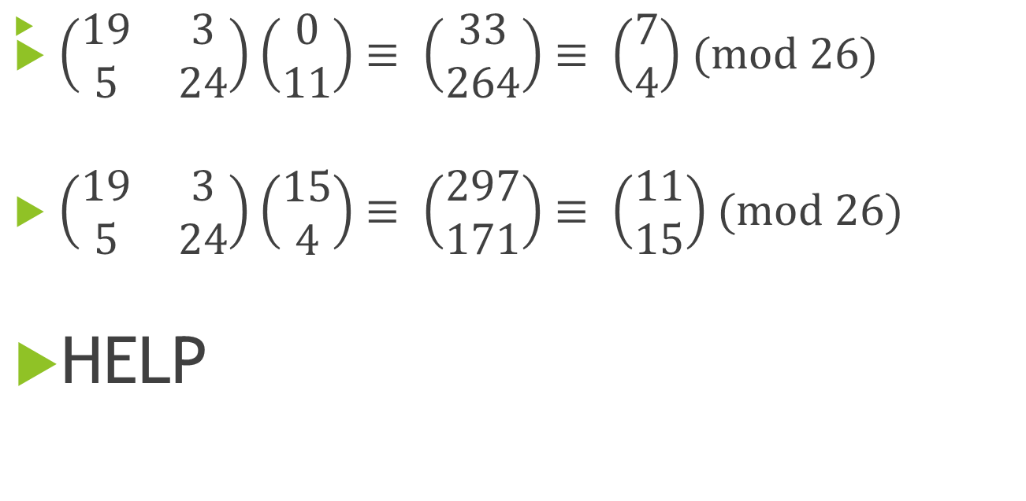
Hill cipher: Encrypting and Decrypting

Slide 22
Presentation Topics
Polygraphic substitution: Razu Biswas, Nayeem Khan
Monoalphabetic cipher: Anupa Das, Sanzida Nitu
Digital signature: Prosanto Deb, Joy Bhowmik
Digital currency: Nadia Islam, Ayesha Nasrin Ripa
Secret sharing: Abdullah Al Tahmid, Sanjatul Hasan
Steganography: Shahriar Ahmed, Alamgir Hossain

